Slide 1
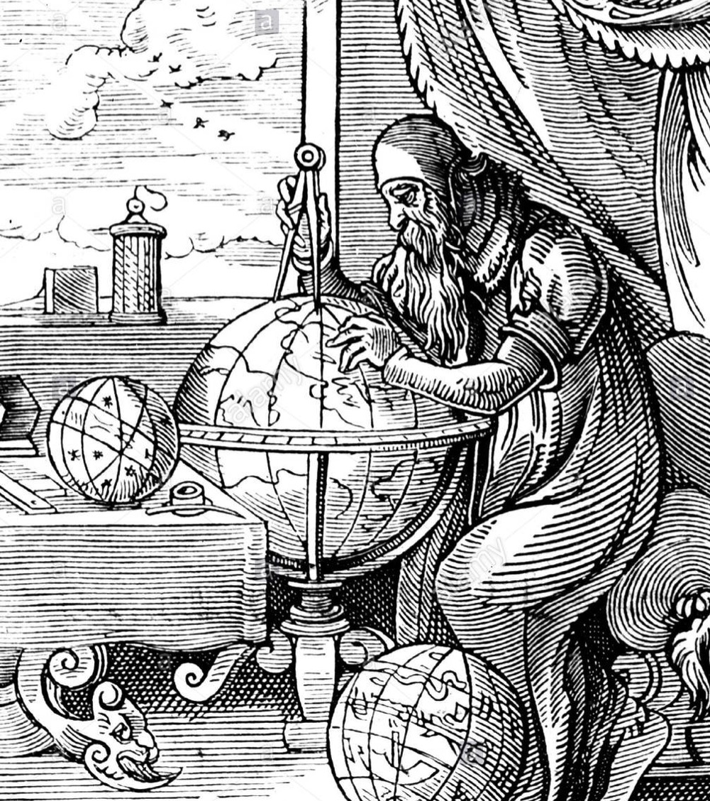
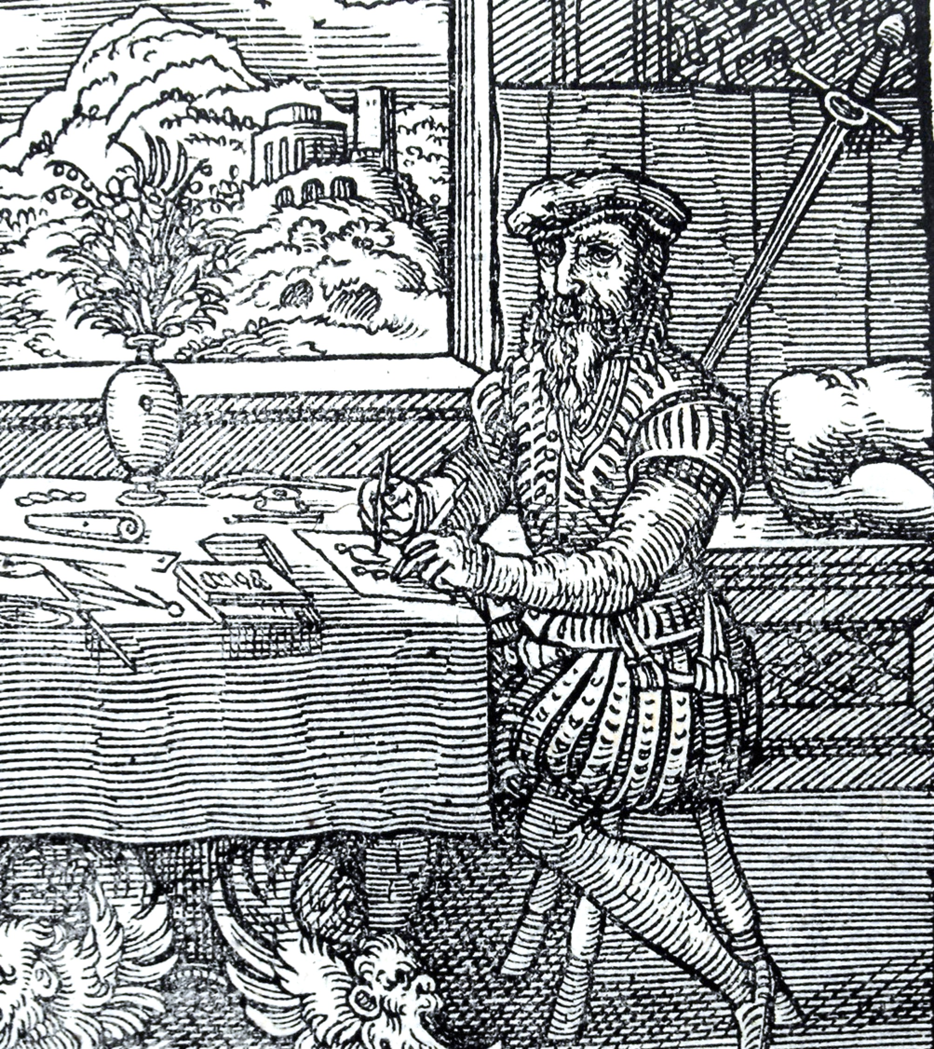
PROBABILITY
PLAUSIBILITY
HUMAN-CENTERED RESEARCH ASSESSMENT
Ruth Schmidt, Institute of Design, IIT
Notes:
Engineer: Grounded in data + tools — “Is this achieving the desired behavioral change?” — Burden of proof = probability
Bricoleur: Grounded in context + pattern — “is this the right problem?” — Burden of proof = plausibility
Just a reminder that fields have been grappling with important issues for a long time — part of why it’s worth looking at intersections
The idea that there’s a “right” or “better” way shows up here as well, through language (modern v. savage) and what is positioned as “progress”…
…because it seems to me, based on what we’ve been chatting about, that the “savage” approach is actually better at complex systems problems
On the other hand, design has long been kind of defensive about its lack of ability to measure what good looks like. This is a real problem to solve
Are these two frames really just different? In competition? Or more complementary? This is what we need to start figuring out
Here’s my POV on what can get us there, though

Slide 2
I. DIVERGE/CONVERGE MODEL
GENERATIVE RESEARCH HELPS US REFRAME PROBLEMS (ARE WE SOLVING THE RIGHT ONE?)
ENSURING FOCUS ON THE APPROPRIATE UNIT OF ANALYSIS
IDENTIFYING ORTHODOXIES OF “HOW THINGS GET DONE AROUND HERE”
PRECURSORS/ANALOGUES PROVIDE INSIGHT INTO ADJACENT SPACE SOLUTIONS
DIVERGE
CONVERGE

Slide 3
SYSTEMS
TOP-DOWN
II. CONDITIONS V. BEHAVIORS
PROCESSES & STRUCTURES
POWER DYNAMICS
ROOT CAUSES
LEVERAGE POINTS
UNINTENDED CONSEQUENCES
MATTHEWS EFFECT
CITING THE TOP SEARCH RESULTS
WHAT’S MEASURED, MATTERS
SENSE OF SELF
MOTIVATIONS
WHAT PEOPLE VALUE
DEFINITIONS
MISCONCEPTIONS
JIF IS EASY TO RANK/COMPARE
QUANTIFICATION FALLACY
(LATENT) USER NEEDS
BOTTOM-UP

Slide 4
III. BEHAVIORAL DESIGN FRAMEWORK
COGNITIVE EFFORT
CONTEXT
ACTION
UNCERTAINTY

Slide 5
IDENTITY VALUE STORY
Kinship
Personal economics
What just “makes sense”
COGNITIVE EFFORT
CONTEXT
ACTION
UNCERTAINTY

Slide 6
IDENTITY VALUE STORY
SIMPLICITY
STRUCTURE
SALIENCE
Kinship
Personal economics
What just “makes sense”
Cognitive load/scarcity
Prioritization
Mental models
COGNITIVE EFFORT
CONTEXT
ACTION
UNCERTAINTY

Slide 7
IDENTITY VALUE STORY
SIMPLICITY
STRUCTURE
SALIENCE
Kinship
Personal economics
What just “makes sense”
Cognitive load/scarcity
Prioritization
Mental models
COGNITIVE EFFORT
REFERENCE POINTS
CONCRETENESS
TRADEOFFS
CONTEXT
Relative losses and gains
What’s “normal”?
The future is abstract
ACTION
UNCERTAINTY

Slide 8
IDENTITY VALUE STORY
SIMPLICITY
STRUCTURE
SALIENCE
Kinship
Personal economics
What just “makes sense”
Cognitive load/scarcity
Prioritization
Mental models
COGNITIVE EFFORT
BARRIERS/FRICTION
OWNERSHIP
INCENTIVES
REFERENCE POINTS
CONCRETENESS
TRADEOFFS
CONTEXT
Too easy not to do
Sense of investment
Urgency
Control
Relative losses and gains
What’s “normal”?
The future is abstract
ACTION
UNCERTAINTY

Slide 9
“It took a lot of persistence and stubbornness, but the paper that more or less lead directly to my Nobel Prize was rejected I think ten times... it’s more important to get stuff out than it is to get it into the best journals”
—Richard Thaler

