Slide 1
Toward Conceptual Clarity in Research Assessment
October 21-23, 2019
Driving Institutional Change for Research Assessment Reform
DORA Meeting
Brian Belcher, PhD.
Sustainability Research Effectiveness Program
Royal Roads University
Victoria, B.C., Canada

Slide 2
Changing expectations of research
Increasing demand for research to have “impact”
Increased focus on social impact
Evolution in research approaches (Mode 2, Utilization-focused research, TDR, Sustainability Science, etc.)
Research assessment for: appraisal; accountability; allocation; advocacy, and; analysis

Slide 3
CGIAR
Vision: Reduce poverty and hunger, improve human health and nutrition, and enhance ecosystem resilience through high-quality international agricultural research, partnership and leadership
15 Research Centers
16 Consortium Research Programs
8,000 scientists, researchers, technicians, and staff
Annual Budget approx. $850M

Slide 4
CGIAR Organizational Reform
More and broader partnerships
Increased emphasis on results-based management
Ambitious 2030 Targets
“Co-responsibility for outcomes”
Notes:
e.g. 100M people exiting poverty (50% women); 500M without nutrient deficiencies; 5M ha saved from deforestation

Slide 5
Responses included:
Fear, confusion, resentment
Conceptualizing & defining research effects in systems context
Theory of change in research planning
Increased inter- & transdisciplinary research
Developing theory-based evaluation approaches
Re-defining research quality beyond disciplinary bounds
Institutional support to facilitate transition

Slide 6
Terms and Definitions
Many definitions and uses of terms “outcome” and “impact” (Belcher and Palenberg 2018)
16 defining elements
Typically defined relatively (e.g. short-term vs long term; immediate vs distal; small scale vs large scale; short duration vs long duration)
We focus instead on the nature of change

Slide 7
Linear model of research impact
Academic
“Research Impact”
Generic “Impact”
Mission-level “Impact”
Research
Knowledge/technology
Uptake and use
Scaling up
The world is a better place
Dissemination
“Knowledge Mobilization”
“Societal Impact”

Slide 8
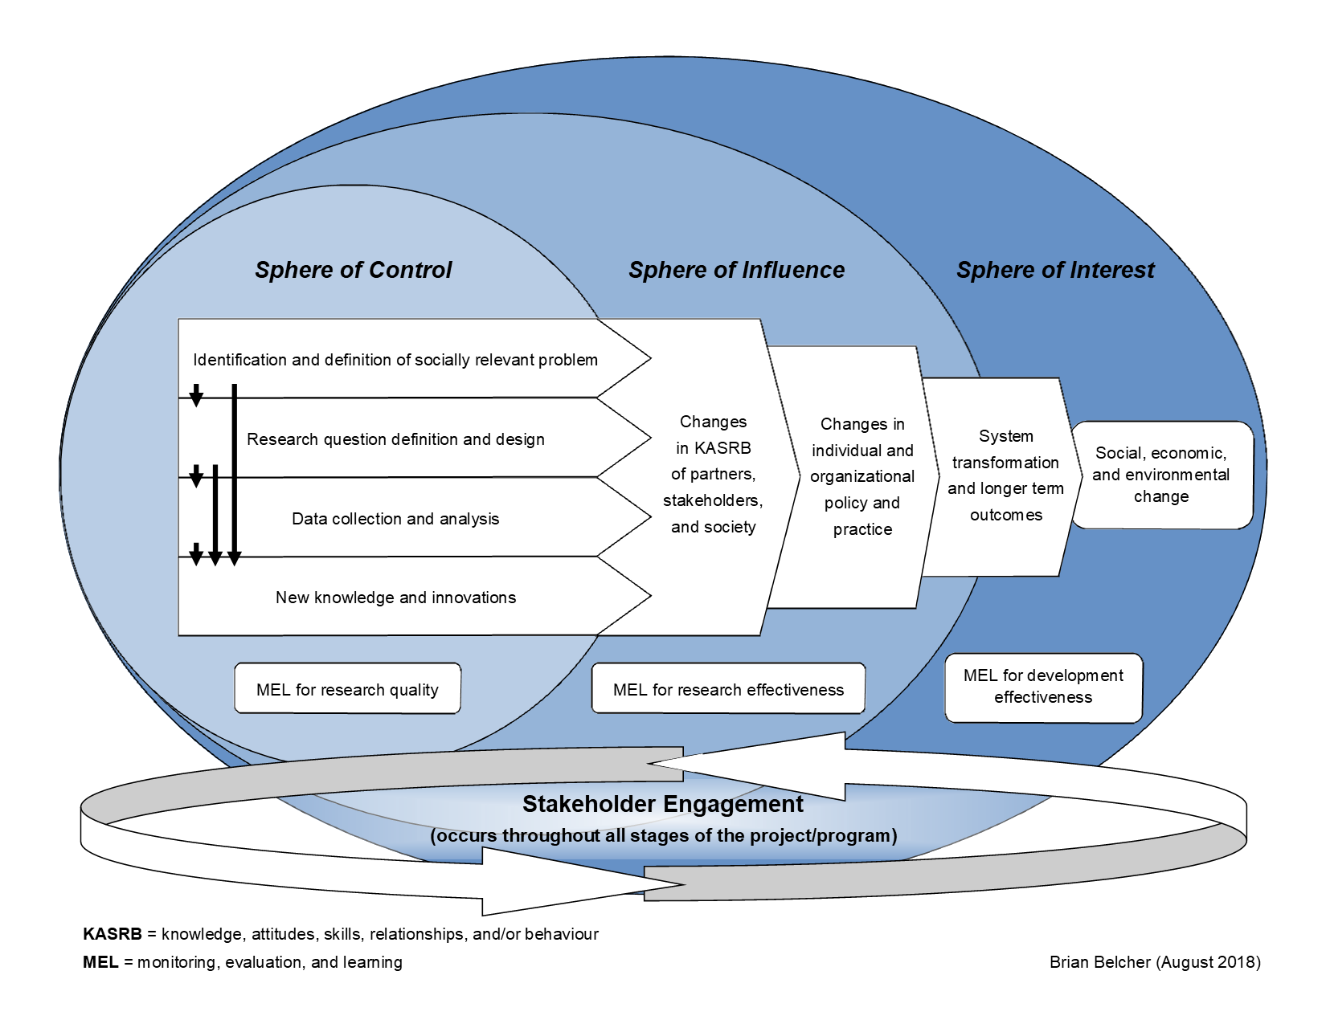

Slide 9
Definitions
Output: New knowledge, technical or institutional advances and other direct products and services produced by a research project or program (sphere of control).

Slide 10
Definitions (cont.)
Output: New knowledge, technical or institutional advances and other direct products and services produced by a research project or program (sphere of control).
Outcome: A change in knowledge, attitudes, skills, and/or relationships (KASR), manifest as a change in behavior, that results in whole or in part from the research and its outputs (spheres of influence & interest).

Slide 11
Definitions (cont.)
Output: New knowledge, technical or institutional advances and other direct products and services produced by a research project or program (sphere of control).
Outcome: A change in knowledge, attitudes skills, and/or relationships (KASR), manifest as a change in behavior, that results in whole or in part from the research and its outputs (spheres of influence & interest).
Realized Benefits (Development Impact): A change in economic, social or environmental condition resulting in whole or in part from a chain of events to which research has contributed (spheres of influence & interest).

Slide 13
Lessons for Changing Research Culture
Make it possible: training; support teams for multiple functions; build and apply theory-based evaluation; end-of-project outcomes;
Make it easy: ToC templates; guidance documents;
Make it normative: build impact culture; appreciate multiple pathways and approaches; 3 pillars;
Make it rewarding: Performance contracts recognize & reward range of contributions; improved donor communications; CGIAR QoR4D framework;
Make it required: System-level targets; Explicit ToC for projects over $100K; Systematic reporting and assessment;
Categories from Nosek 2019

Slide 14
References and Resources
Sustainability Research Effectiveness website: www.researcheffectiveness.ca
Belcher, B. & Palenberg, M. (2018). Outcomes and Impacts of Development Interventions: Toward Conceptual Clarity. American Journal of Evaluation, 39(4), 478-495.
Belcher, B. M., Rasmussen, K. E., Kemshaw, M. R., & Zornes, D. A. (2016). Defining and assessing research quality in a transdisciplinary context. Research Evaluation, 25(1), 1-17.
Nosek, B. (2019). Strategy for Culture Change. Centre for Open Science blog.
https://cos.io/blog/strategy-culture-change/Follow us on Twitter @SREffectiveness

Slide 15
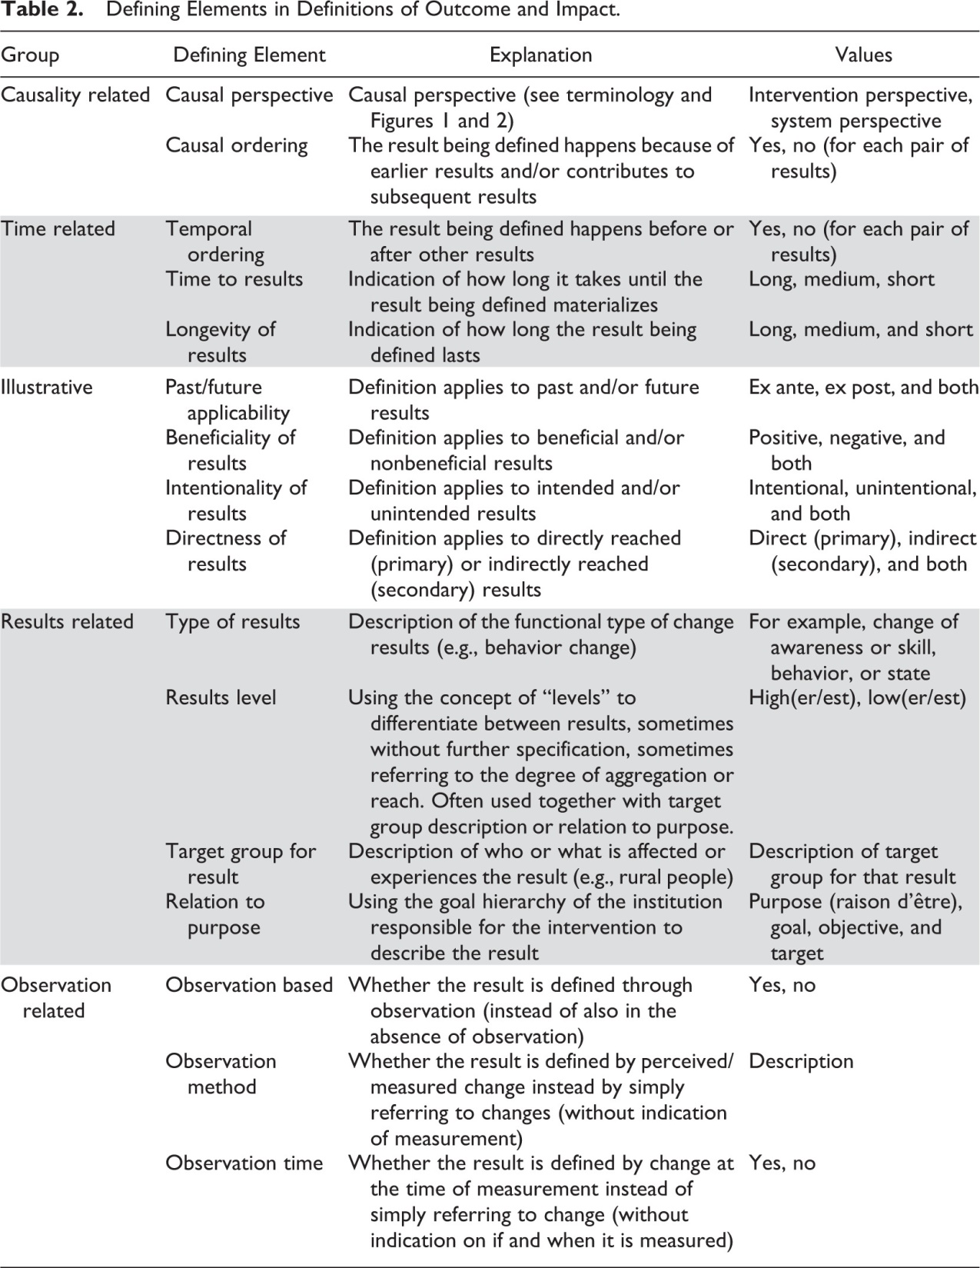

Slide 16
